Slide 1

Correspondence
CHAPTER: 6
Business Letters

Slide 2
Purpose
Business letters are written to inform readers of specific information.
You might also write a business letter to persuade others to take action.
Business letters even function as advertisements, like in case of Sales Letter.

Slide 3
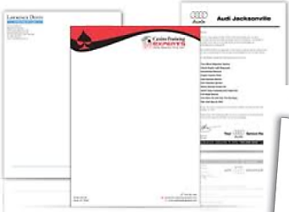
Letterhead is designed to convey a positive image of the company.
Letterhead includes:
company's logo
address
phone number
identifying graphic/logo

Slide 4
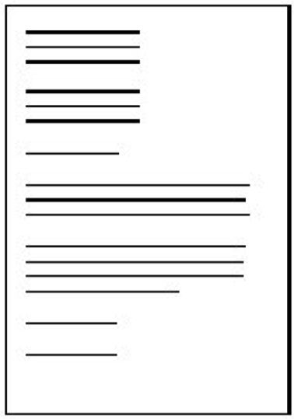
Letter Format
The fully block open punctuation style is the most common format for business letters.
All the elements are lined up along an invisible line down the left side of the page. The text is single spaced, with no indent at the first paragraph of the sentence.

Slide 5
Notes:
Full Block Form
Modified Block Form
Out of the two, this is Full Block format.
All lines in the letter begin at the left margin (no tabbing or indenting)

Slide 6
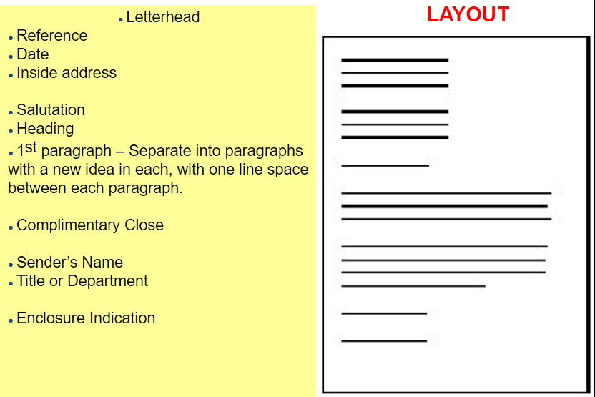

Slide 7
Examples of opening lines
I am writing to enquire about …
After having seen your advertisement in … , I would like …
After having received your address from … , I …
I received your address from … and would like …
With reference to your letter of 8 June, I …
We/I recently wrote to you about …
Thank you for your letter of 8 May.
Thank you for your letter regarding..
Thank you for your letter/e-mail about …
In reply to your letter of 8 May…
Notes:
We need an opening line in a business letter to make reference to previous correspondence; to say how we found the recipient’s name/address; to say why we are writing to the recipient.

Slide 8
Examples of closing lines
We look forward to a successful working relationship in the future.
Should you need any further information, please do not hesitate to contact me.
Once again, I apologize for any inconvenience.
We hope that we may continue to rely on your valued custom.
I would appreciate your immediate attention to this matter.
Notes:
We need a closing line in a business letter or email: to make a reference to a
future event, to repeat an apology and to offer help.

Slide 9
Parts of a Letter
Letterhead of your Organization
Date
Inside Address
Subject Line
Salutation
Body
Complimentary Closing
Writer’s Signature Block
Your full name (typed)
End Notations CC

Slide 10
Heading or Letterhead
Place your full return address and the date in the heading (if no letterhead).
Avoid writing name (your name appears at the end of the letter)
Spell out words such as street, avenue, first, and west rather than abbreviating them.
The date usually goes directly beneath the last line of the return address. Avoid abbreviating the name of the month.
Begin the heading about two inches from the top of the page.
If you are using letterhead that gives the company address, enter only the date, below the last line of the letterhead.

Slide 11
Inside Address
the recipient’s full name
Title/designation
address in the inside address,
One line below the date, depending on the length of the letter

Slide 12
Subject Line
An optional element in a letter is a subject line.
It follows the recipient’s address
Insert one blank line above and one blank line below the subject line.
The subject line in a letter functions as an aid in focusing the topic and filing the letter.
Subject lines are especially useful if you are writing to a large company and do not know the name or title of the recipient. In such cases, you may address a letter to an appropriate department or identify the subject in a subject line and use no salutation.
Notes:
(For information on subject lines, read pages 122–123 of The Business Writer's Handbook.)

Slide 13
Salutation
In most business letters, the salutation contains the recipient’s personal title (such as Mr., Ms., Dr.) and last name, followed by a colon (:).
If you are on a first-name basis with the recipient, use only the first name in the salutation.
Address women as Ms. unless they have expressed a preference for Miss or Mrs.
Professional titles (such as Professor, Senator, Major) take precedence over Ms. and similar courtesy titles.
When a person’s first name could refer to either a woman or a man, one solution is to use both the first and last names in the salutation.
Avoid “To Whom It May Concern” because it is impersonal and dated.
Dear Professor Ali and Dr. Alishba: [two recipients], Dear Ms. Asma, Ms. Aleena, and Mr. Asim: [three recipients], Dear Colleagues: [Members, or other suitable collective term].
In other circumstances in which you do not know the recipient’s name, use a title appropriate to the context of the letter, such as Dear Customer or Dear IT Professional.
Dear Sir/Madam
Notes:
Place the salutation, or greeting, below the subject and the inside address and align it with the left margin.

Slide 14
Body
The body of the letter should begin a line below the salutation
Leave a line within paragraphs
To provide a fuller appearance to a very short letter, you can increase the side margins, increase the font size and insert extra space above the inside address, the writer’s signature block, and the initials of the person typing the letter..
Components of Body:
Purpose
Details
Call for Action
Closing off
Notes:
Also read about the ABC format in the Correspondence guidelines.

Slide 15
Complimentary Closing
Type the complimentary closing a space below the body.
Use a standard expression such as Sincerely, Yours sincerely or Yours truly.
If the recipient is a friend as well as a business associate, you can use a less-formal closing such as Best wishes or Best regards or, simply, Best.
Capitalize only the initial letter of the first word, and follow the expression with a comma (,).

Slide 16
Writer’s Signature Block
Type your full name four lines below and aligned with the complimentary closing.
Sign the letter in the space between the complimentary closing and your name.
On the next line include your business title, if appropriate.
The following lines may contain individual contact information, such as a telephone number or an e-mail address, if not included in the letterhead or the body of your letter.

Slide 17
End Notations
Reference initials show the letter writer’s initials in capital letters, followed by a slash mark (or colon), and then the initials of the person typing the letter in lowercase letters (When the writer is also the person typing the letter, no initials are needed).
Enclosure notations indicate that the writer is sending material along with the letter (an invoice, an article, and so on).
Enclosure notations may take several forms: Enclosure: Final Safety Report
Copy notation (“cc:”) tells the reader that a copy of the letter is being sent to the named recipient(s).
Use a blind-copy notation (“bcc:”) when you do not want the addressee to know that a copy is being sent to someone else. A blind-copy notation appears only on the copy, not on the original (“bcc: Dr. Ali Afzal”).
Notes:
Business letters sometimes require additional information placed at the left margin.
two spaces below the typed name and title of the writer in a long letter, four spaces below in a short letter.

Slide 18
Types of Business Letters
Invitations
Instructions
Answer to Inquiry
Complaint
Adjustment
Reference
Advice
Introducing new business
Amalgamation of business
Acknowledgement
POSITIVE
NEGATIVE
NEUTRAL
PERSUASIVE
Notes:
Fall under 4 broad categories

Slide 19
1. Letter of Acknowledgement
Sent to acknowledge receipt of something when a written record is appropriate.
An acknowledge may also be sent to acknowledge receipt of another letter or document which requires further attention. As such you would clearly state that you will look into the matter and reply in more detail at a later date.

Slide 20
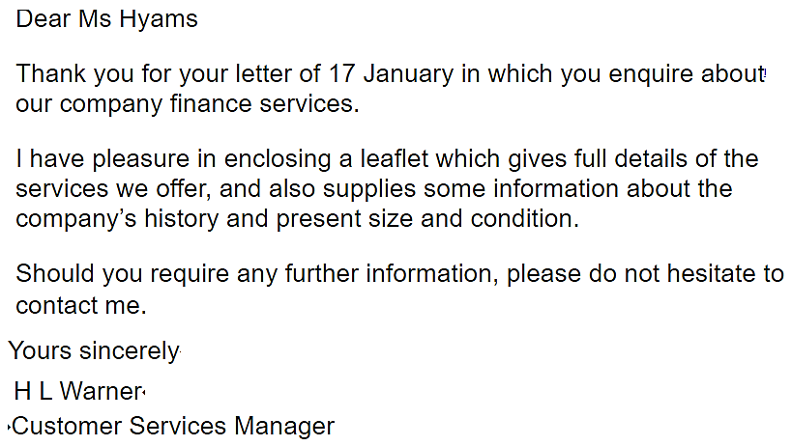

Slide 21
2. LETTER OF ENQUIRY
Enquiries for information about goods or services are sent and received in business all the time.
In your letter remember to state clearly exactly what you want – information? a catalogue? a price list? a quotation?
Keep your enquiry brief and to the point.

Slide 22
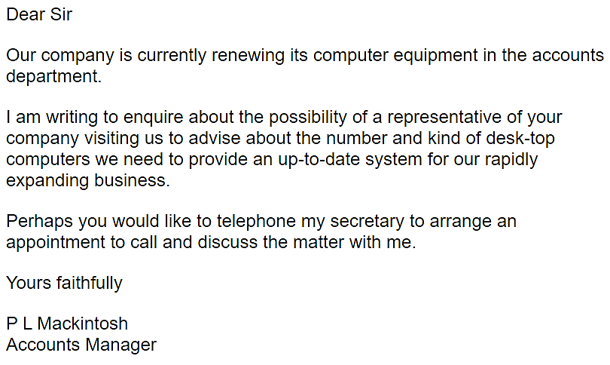

Slide 23
3. Letter of Complaint
When you have a genuine complaint, you will feel angry but remember that the other party may not to be blame .
They may have a perfectly good defense. Therefore, your letter should be confined to a statement of the facts followed by an enquiry about what the company will do about it or a suggestion of how you expect the matter to be dealt with.
At all costs avoid rudeness .
Notes:
There are bound to be occasions in business when you have to make a complaint, or deal with one.

Slide 24
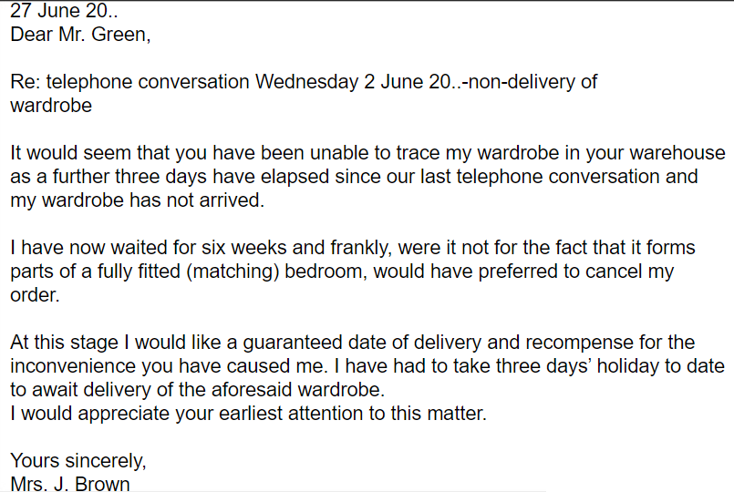

Slide 25
USEFUL PHRASES FOR LETTER OF COMPLAINT
I am displeased with the quality of these goods.
This is causing us a great deal of inconvenience.
​Please look into this and arrange for the goods to be replaced.
These goods are well below the standard expected.
I expect to receive a complete refund soon.
​The standard of workmanship is totally inadequate.
​You assured me that you would deliver these goods within one week.

Slide 26
4. Adjustment Letter
Adjustment letter gives an opportunity to investigate, explain and put things right.

Slide 27
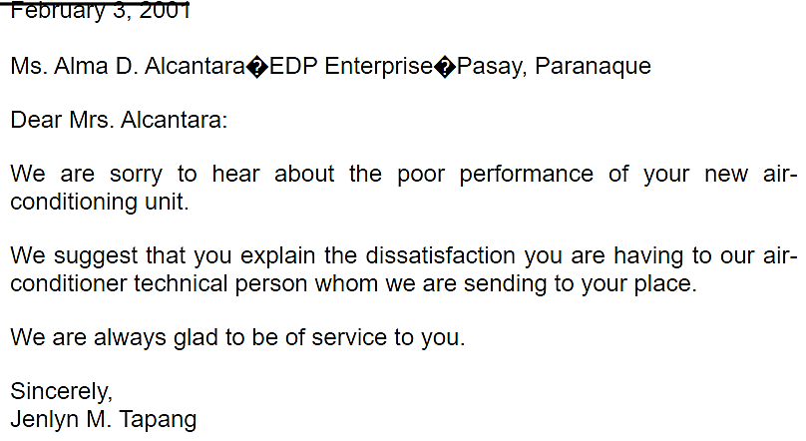

Slide 28
USEFUL PHRASES FOR LETTER OF ADJUSTMENT
I have looked into this matter and have found out that…
I am very sorry to hear about...
Please accept my apologies for any inconvenience caused.
Thank you for bringing the matter to our attention.
​I sincerely hope that you will have no further problems with this replacement order.

Slide 29
Don’ts of Letter Writing
Make grammar or usage errors
Use clichés or worn-out phrases
Use obsolete and/or pompous language because it "seems" more professional
Be too familiar with your audience
Use humor unless you know what you are doing
Preach
Brag

Slide 30
Don’ts of Letter Writing
Use plain English
Write in active voice when possible
Use short sentences when possible
Use everyday words and avoid technical jargon
Use lists to present complex materials
Select the words you use very carefully
Use a strong organizational strategy
Use a reader centered tone
Use a business like, conversational tone

Slide 31
Correspondence Guidelines
1. Know Your Purpose
2. Know Your Readers
3. Follow Correct Format (CONTENT + FORMAT)
4. Follow ABC Format
5. Follow the 3 Cs Strategy (Capture, Convince, Contact)
6. Stress the You Attitude
7. Use Attachment for Details
8. Be Diplomatic
9. Edit Carefully
10. Respond Quickly

Slide 32
Letter vs Memo
Letter
Memo
A memo is used internally within an organization moving upward, downward or horizontally. It is never sent outside.
A memo may omit return address, salutation, complimentary close if it uses To, from, Date and Subject heading.
Memo can use technical jargons and abbreviations because their meaning is understood by the people within the organization.
Letters are used both external communication (mostly)
A letter requires inside address, Salutation and complimentary close.
Communicating to external people through letter, simple words are encouraged rather than jargons.

Slide 33
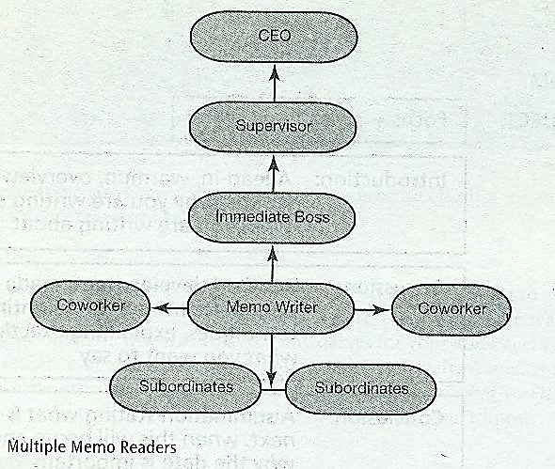

Slide 34
PURPOSES
Documentation – report on expenses, incidents, accidents, problems encountered, projected costs, study findings, hiring, firings, and relocation of staff or equipment. | Procedures – explain how to set up accounts, operate new machinery, use new software, create a new company Web site, or solve a problem.
Cover/transmittal – tell the reader you have attached a document. | Confirmation – tell the reader about a meeting agenda, date, time, and location; decision to purchase or sell; conclusion arrived at; and fees, costs or expenditure.
Feasibility – study the possibility of changes in the workplace (practices, procedures, location, staffing, equipment, mission or visions). | Status – provide a daily, weekly, monthly, quarterly, biannual, or yearly progress report about sales, staffing, travel, practices, procedures and finances.
Recommendations – provide reasons to purchase new equipment, fire or hire personnel, contract with new providers, merge with other companies, revise current practices and review contracts. | Inquiry – ask questions about upcoming processes, procedures, or assignments

Slide 35
Memos should contain the following key components:
Memo ID
Introduction
Discussion
Conclusion
DATE:
TO:
FROM:
SUBJECT:
Focus + Topic
Introduction: A lead-in, warm up, overview, stating why you are writing and what you are writing about
Discussion: Detailed development, made accessible through highlighting techniques, explaining exactly what you want to say
Conclusion: A summation stating what is next, when this will occur, and why the date is important

Slide 36
EXAMPLES
One-word subject lines don’t communicate effectively, e.g.
Flawed: Subject: COMPTROLLERS
Corrected: Subject: Salary Increase For Comptrollers
Introduction - example
In the third of our series of quality control meetings this quarter, I’d like to get together again to determine if improvements have been made.
As a follow-up to our phone conversation yesterday (8/12/05). I have met with your VP regarding your suggestions, He’d like to meet with you to discuss the following ideas in more detail.

Slide 37
EXAMPLES
Conclusion
A complimentary close: If our quarterly sales continue to improve at this rate, we will double our sales expectations by 2005. Congratulation!
A directive close: Next Wednesday (12/22/05), Mr. Jones will provide each of you a timetable of events and a summary of accomplishments.

Slide 38
